Slide 1
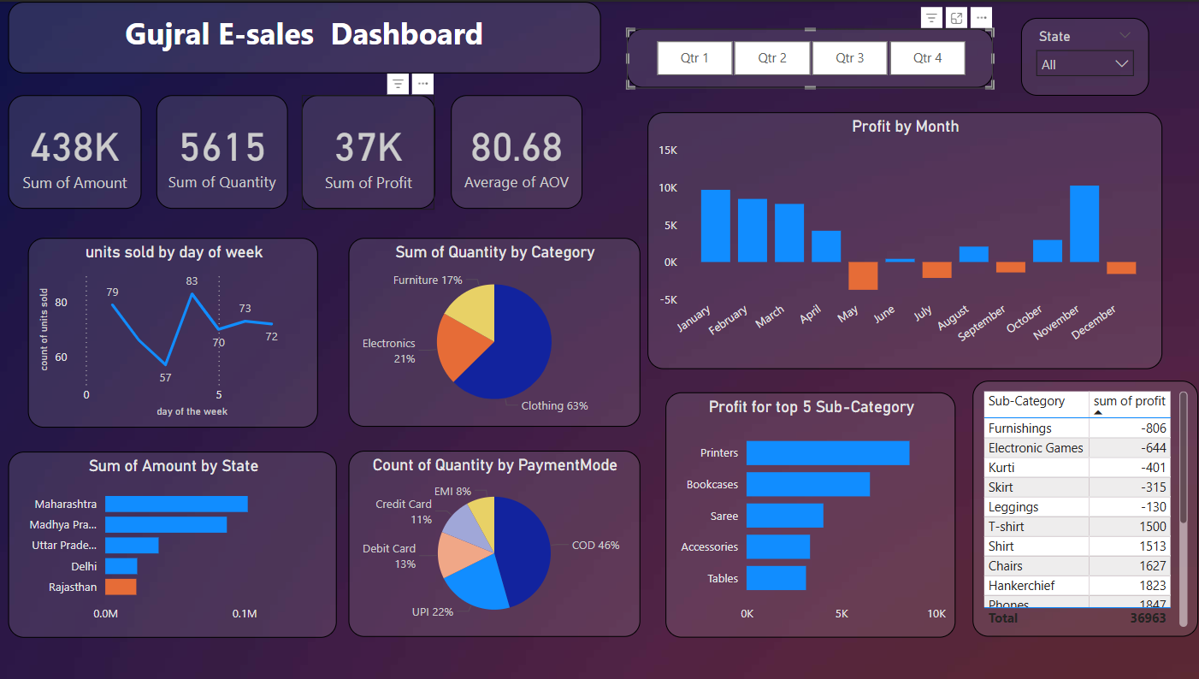
Overview of Gujral E-sales Dashboard
Introduction
The Gujral E-sales Dashboard serves as a vital tool for business stakeholders, providing a comprehensive overview of sales performance and key metrics.
Purpose and Significance
Performance evaluation: The dashboard allows stakeholders to assess business performance through critical sales data.
Strategic decision-making: Insights derived from the dashboard can inform marketing strategies, inventory management, and financial planning.

Slide 2
Key Metrics: Total Sales Amount
₹438K
5,615 units
₹37K
₹550K
Total sales amount recorded
Total quantity sold
Total profit achieved
Future sales targets

Slide 3
Time-Based Analysis: Profit by Month
₹40K
₹8,871
QTR 3
₹80.68
Average Order Value (AOV)
Positive profits observed in January to April and November
Losses recorded in June, July, and December
Indications of seasonal impacts

Slide 4
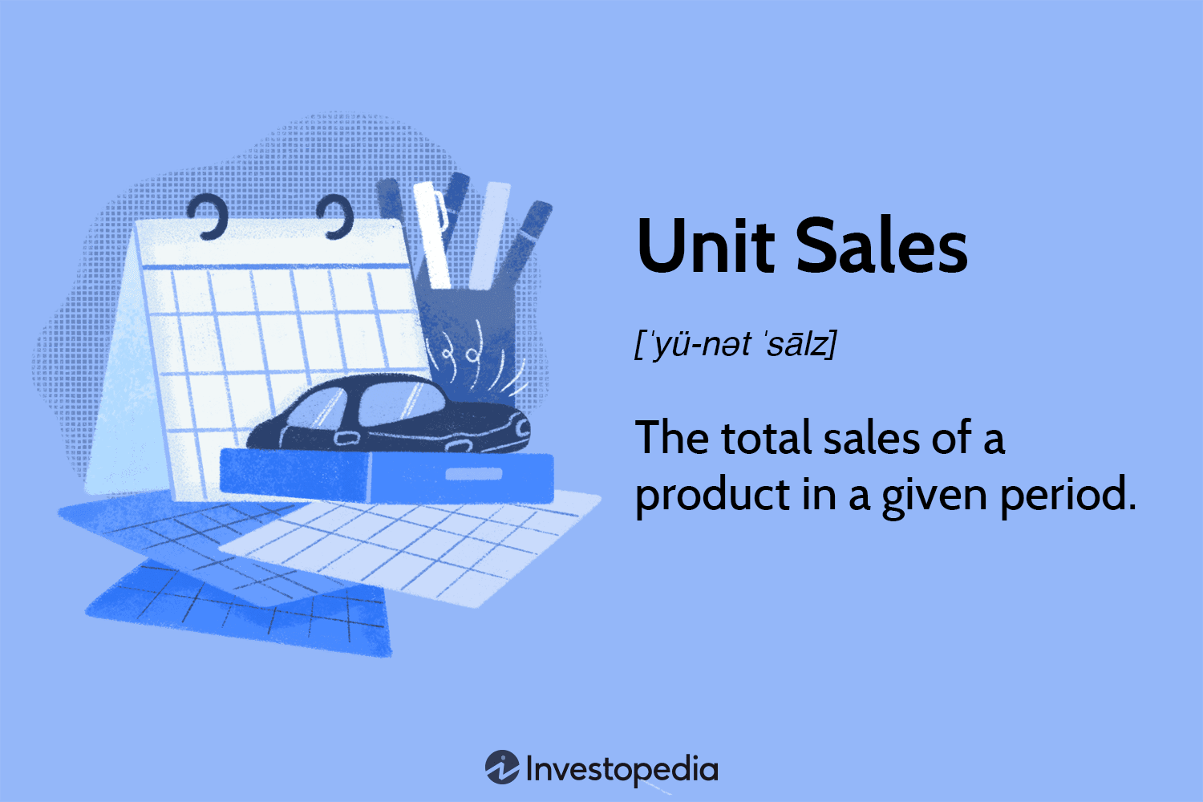
Time-Based Analysis: Units Sold by Day of Week
Distribution of Units Sold: Analyzing the distribution of units sold by day of the week can highlight purchasing patterns.
The analysis of units sold across the days of the week reveals clear patterns in consumer purchasing behavior. Wednesday stands out with the highest sales volume (83 units), suggesting that midweek may be a strategic time when customers are most active—possibly due to midweek promotions, salary cycles, or lower competition for attention compared to weekends.
Conversely, Friday shows the lowest sales (57 units), which might indicate a shift in consumer focus toward weekends or leisure activities. Sales on other days like Monday (79), Tuesday (66), and Sunday (72) maintain moderate volumes.
Sales patterns: Identifying peak sales days can inform marketing strategies and promotional timing.
Strategic planning: Understanding these patterns can help optimize inventory and staffing.

Slide 5
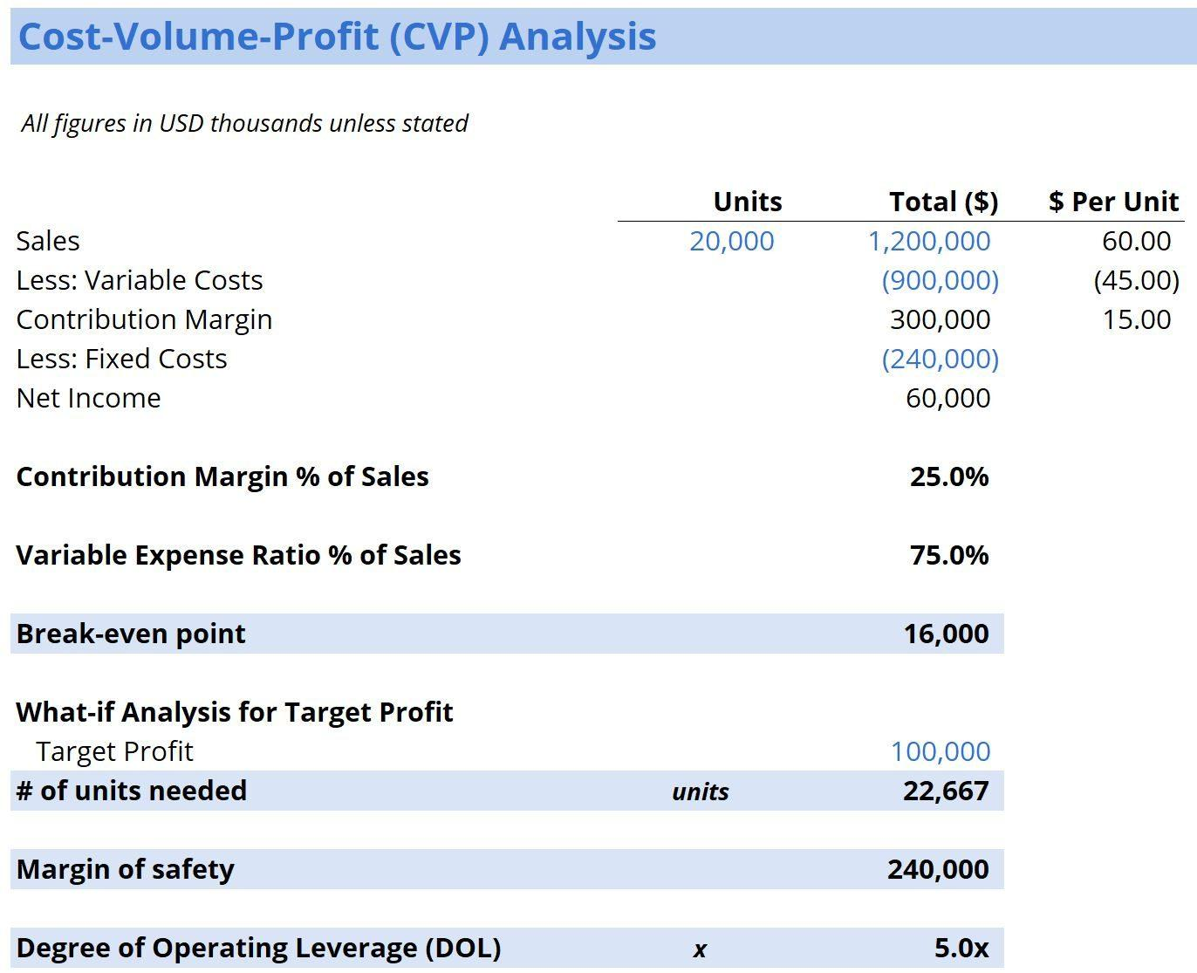
Product Insights: Profit by Sub-Category
Profitable Sub-Categories: The analysis of profit by sub-category reveals the following:
Top 3 Profitable Sub-Categories:
Phones
Handkerchief
Chairs
Least Profitable Items:
Furnishings (-₹806)
Electronic Games
Kurti
Implications:
Focus on profitability: Stakeholders should prioritize high-profit sub-categories while investigating the reasons behind losses in less profitable items.

Slide 6
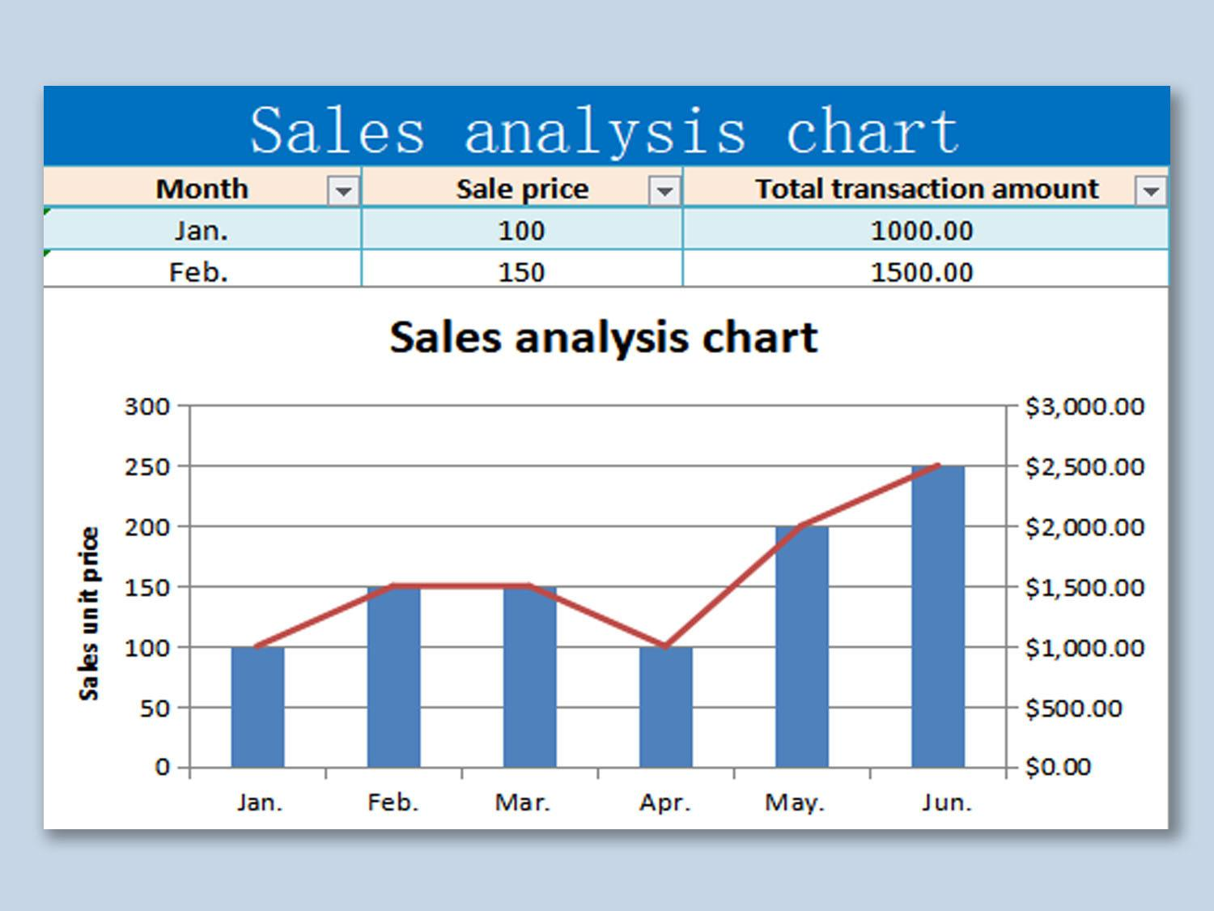
Regional Performance: Sum of Amount by State
🏆 Maharashtra is the top-performing state, contributing the highest revenue among all regions.
🔝 Madhya Pradesh and Uttar Pradesh follow closely, indicating strong sales in central and northern regions.
📈 Delhi shows a positive sales trend, suggesting good engagement and possibly strong urban demand.
⚠️ Rajasthan shows negative revenue, signaling losses or underperformance—likely due to low sales, high returns, or heavy discounts.
📊 Overall, there's a noticeable disparity in performance between states, which highlights the need for region-specific strategies.
🎯 Actionable Insight: Focus on boosting sales in low-performing states like Rajasthan and replicating successful tactics from high-performing regions.
Regional analysis: Identifying high-performing states can highlight areas for growth and targeted marketing efforts.
Strategic focus: Understanding regional dynamics can inform resource allocation and sales strategies.

Slide 7
Payment Mode Distribution: Most Used Mode
46%
22%
13%
11%
Cash on Delivery (COD) usage
UPI usage
Debit Card usage
Credit Card usage

Slide 8

Insights & Takeaways
Key Insights:
Clothing dominance: While clothing drives major sales volume, it may not be the most profitable category.
Revenue losses: Specific months and regions show revenue losses that require further investigation.
Digital payment potential: The high usage of COD presents an opportunity to promote digital payment options, potentially increasing efficiency and customer satisfaction.
June and December show notable losses, possibly due to inventory markdowns, high returns, or discounts.
High order volume with moderate AOV (₹80.68) suggests scope to bundle products or introduce upselling strategies.

Slide 9

Conclusion
The Gujral E-sales Dashboard reveals key insights into our sales performance across product categories, states, and time. While overall sales volume and revenue appear strong, profits are concentrated in select sub-categories, with some segments showing consistent losses. Clothing leads in quantity sold, but high-volume doesn’t always translate to high profitability. Regional analysis shows Maharashtra and MP as top contributors, whereas Rajasthan underperforms. Seasonal fluctuations and a heavy reliance on Cash on Delivery highlight opportunities for operational improvements, promotional targeting, and payment optimization. These findings call for data-driven strategies to boost margins, streamline operations, and enhance customer engagement.

